Slide 1
Fake News Project
Submitted by-
Madhurima Srivastava
Internship 30

Slide 2
INTRODUCTION
Fake news is defined as a made-up story with an intention to deceive or to mislead. The rate of production of fake news has increased exponentially. In the past news obtained from newspaper, radio or TV were considered as the best and authentic source of information about the real world and ongoing situations but now everything has changed. In the run of popularity and ill mind set the media houses and social media are spreading fake news. It’s becoming harder and harder to say whether a piece of news is real or fabricated.
The effect of fake news can be seen everywhere. The fake news leads to communal disturbance, character assassination, mental trauma, sometimes it is used as a weapon to achieve some illicit plans etc. these are like wild fire which spread too quickly and difficult to control. Which creates difficulty in differentiating between fake news and authentic news.
Technologies such as Artificial Intelligence (AI) and Natural Language Processing (NLP) tools offer great promise for researchers to build systems which could automatically detect fake news. However, detecting fake news is a challenging task to accomplish as it requires models to summarize the news and compare it to the actual news in order to classify it as fake. Moreover, the task of comparing proposed news with the original news itself is a daunting task as it's highly subjective and opinionated.
The goal is to build a prototype to classify the news as fake or not fakes in order to bring awareness and reduce unwanted chaos.

Slide 3
DATA SOURCES AND THEIR FORMATS
You can find many datasets for fake news detection on Kaggle or many other sites. This is datasets from Kaggle. There are two datasets one for fake news and one for true news. In true news, there is 21417 news, and in fake news, there is 23481 news. You have to insert one label column zero for fake news and one for true news. We are combined both datasets using pandas built-in function.
Some Useful Links-
1-https://www.javatpoint.com/nlp
2-https://www.educative.io/answers/preprocessing-steps-in-natural-language-processing-nlp
3-https://www.youtube.com/watch?v=5ctbvkAMQO4
4-https://www.youtube.com/watch?v=X2vAabgKiuM

Slide 4
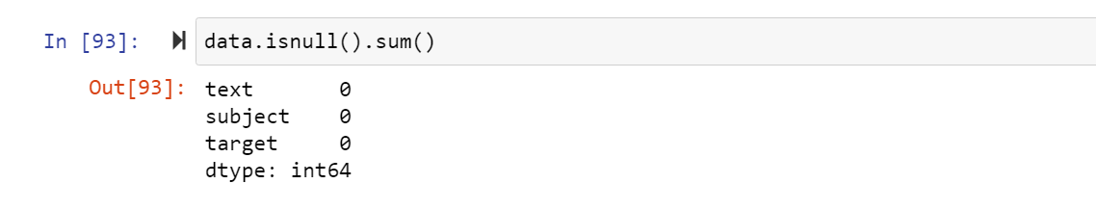
DATA PRE-PROCESSING
Checking the missing values
Moving ahead, cleaning the dataset will remove errors which in turn will increase productivity and render highest quality information in decision making. Here, in this dataset, the null values are checked using isnull().sum(), which results in getting 2 features having null values in actual.
As we can see there is no null values , so we do not have to treat missing values in here.

Slide 5
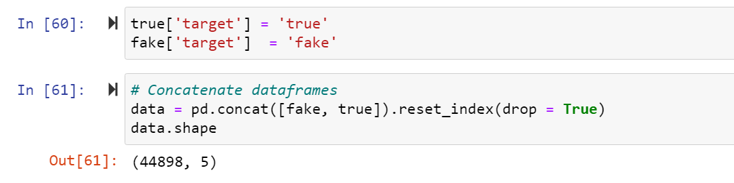
Now , we are connecting both true and false table with eash other with concat code and putting fake as fake and true as true in a new table target.

Slide 6
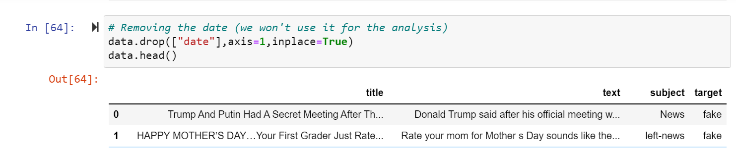
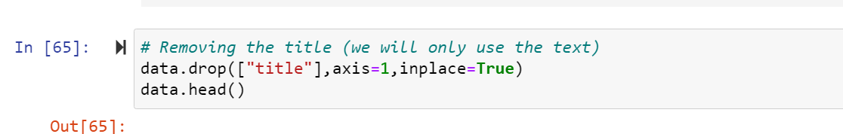
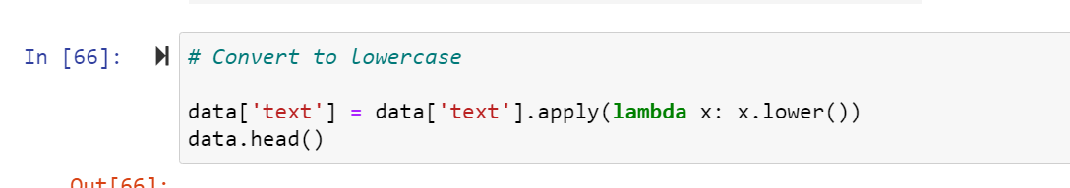
Dropping unnecessary data

Slide 7
Preprocessing using NLP
Data cleaning is the process of preparing data for analysis by removing or modifying data that is incorrect, incomplete, irrelevant, duplicated, or improperly formatted. This data is usually not necessary or helpful when it comes to analysing data because it may hinder the process or provide inaccurate results.
Before cleaning the data, a new column is created named ‘length_before_cleaning’ which shows the total length of the news respectively before cleaning the text.
The following steps were taken in order to clean the text:
Transform the text into lower case.
Replaced the email addresses with the text 'emailaddress'
Replaced the URLs with the text 'webaddress'
Removed the HTML tags
Removed the numbers
Removed extra newlines
Removed the punctuations
Removed the unwanted white spaces
Removed the remaining tokens that are not alphabetic
Removed the stop words
We also created new features for comparing the original length before cleaning and the new length after cleaning.

Slide 8
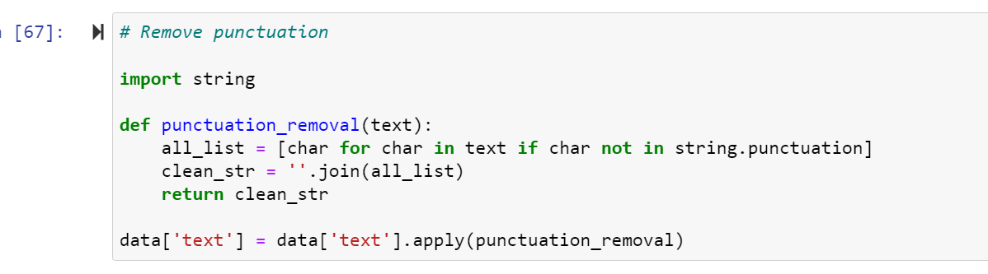
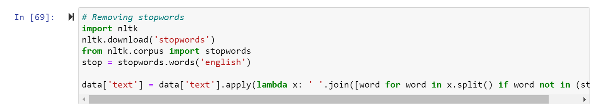

Slide 9
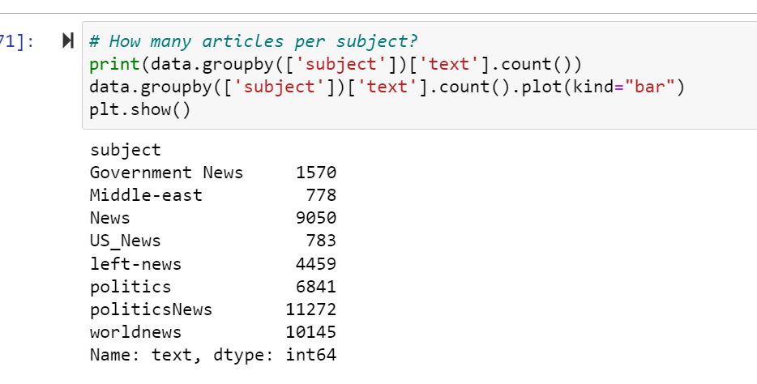
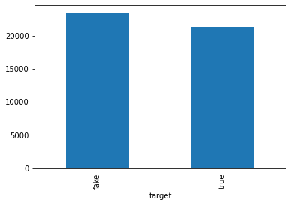
Basic data exploration
Plotting bar tables

Slide 10
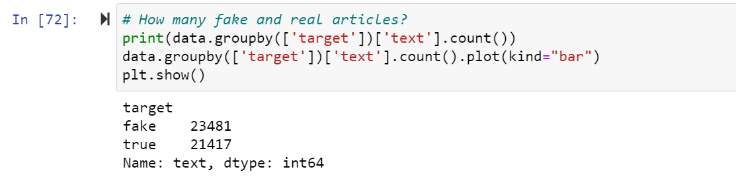

Slide 11
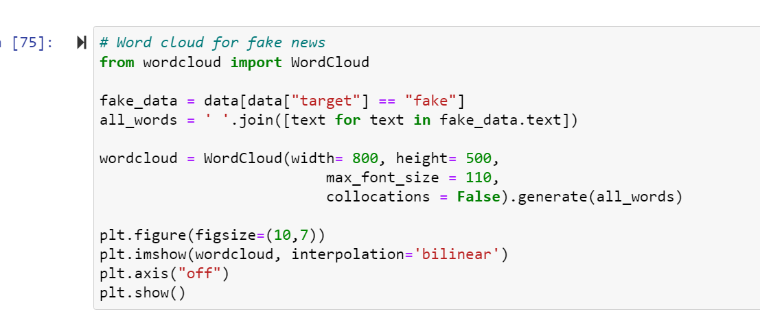
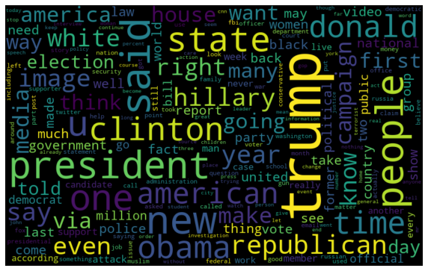

Slide 12
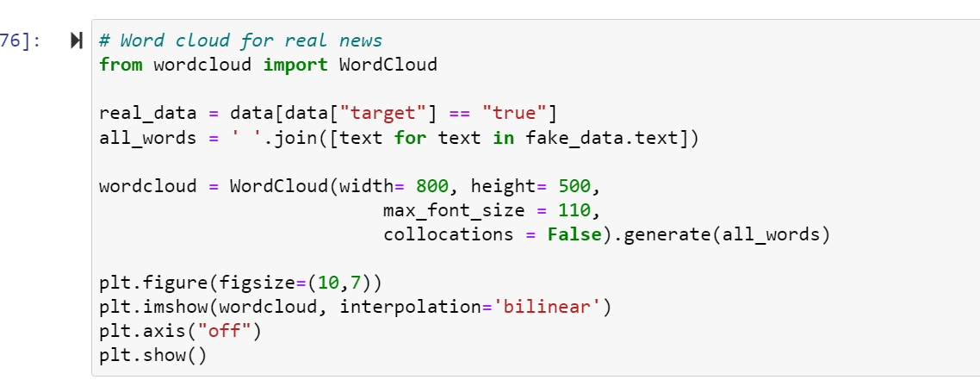
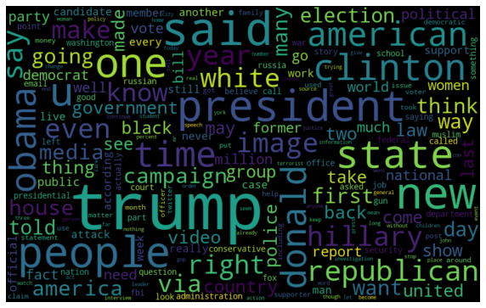

Slide 13
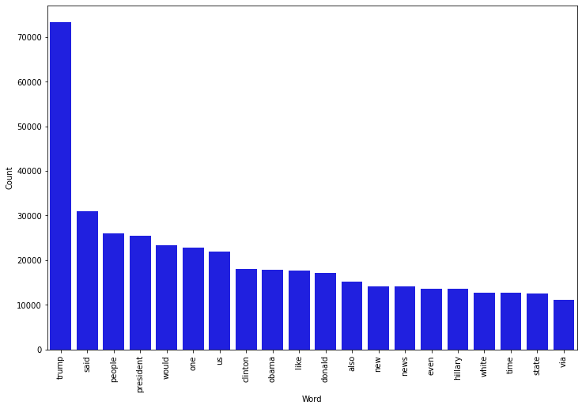
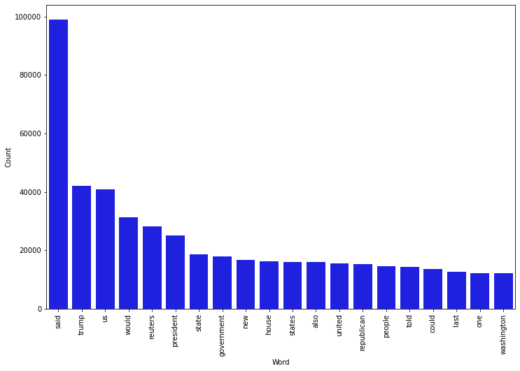
Most Frequent words in the fake News-
Most frequent words in real news

Slide 14
MODEL/S DEVELOPMENT AND EVALUATION
Splitting the train and test data
Training and testing the models minimize the effects of data discrepancies and better understand the characteristics of the model. The training data is used to make the machine recognize patterns in the data and the test data is used to see how well the machine can predict new answers based on its training. ‘X’ and ‘y’ were split for training and testing using train_test_split.
Building the model
Running various algorithms, for the final results
After running the algorithms and according to the scores of performance metrics and other scores, we can see that Logistic Regression and RandomForest Classifier algorithms are performing well. Now, we will perform Hyperparameter Tuning to find out the best parameters and try to increase the scores.

Slide 15
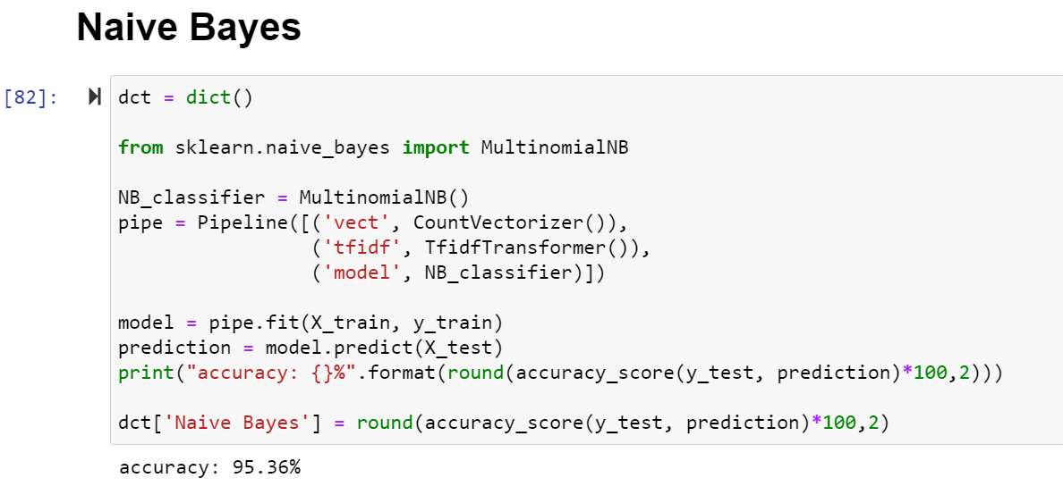
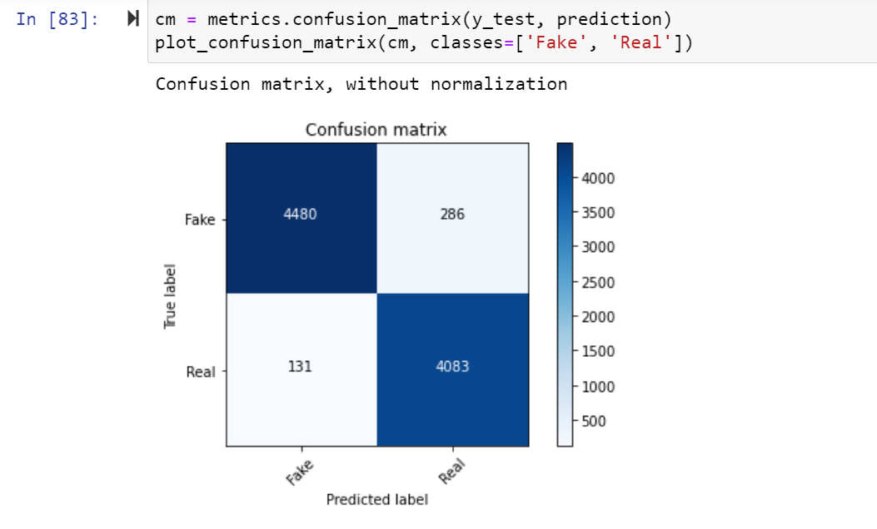
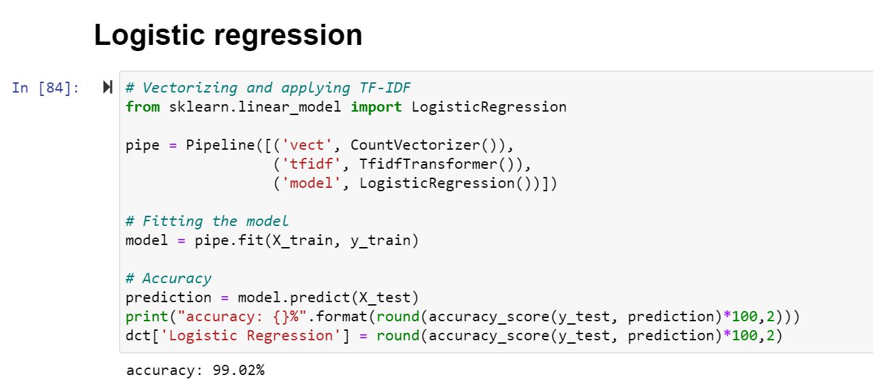
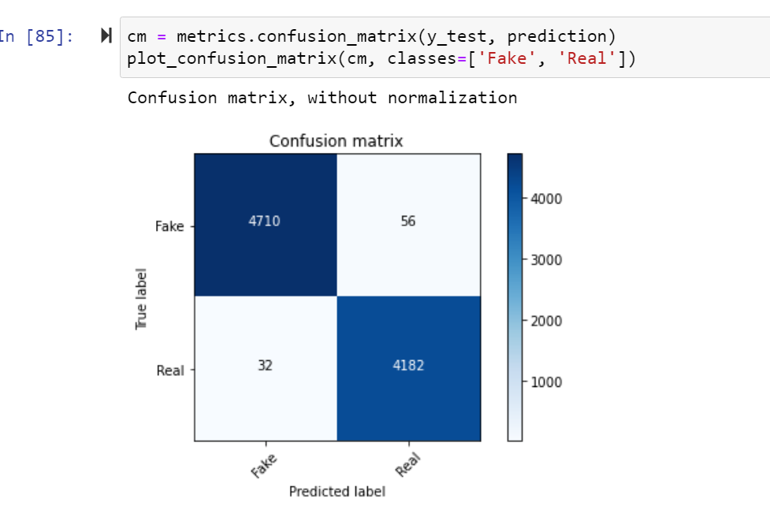

Slide 16
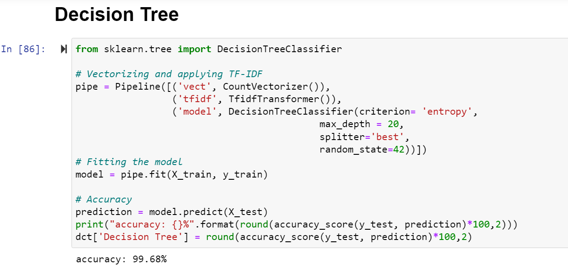
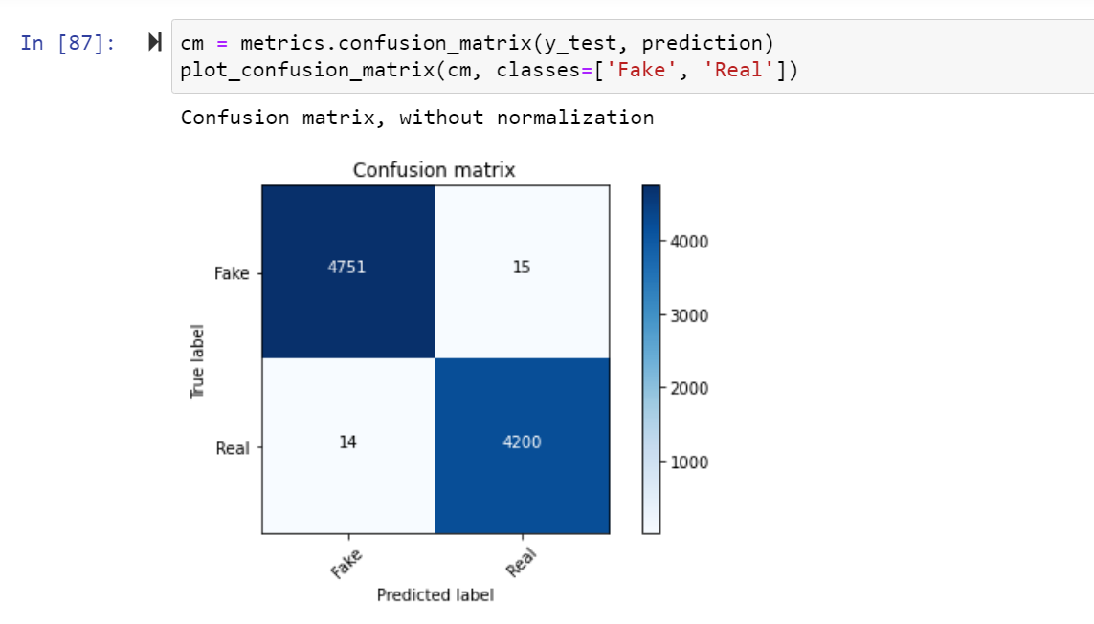
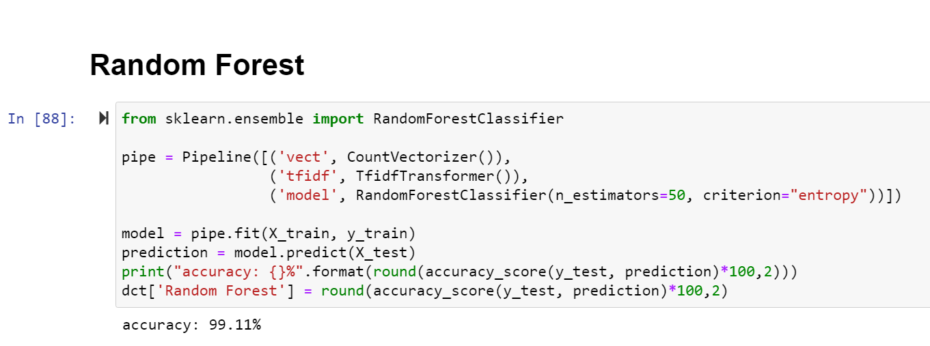
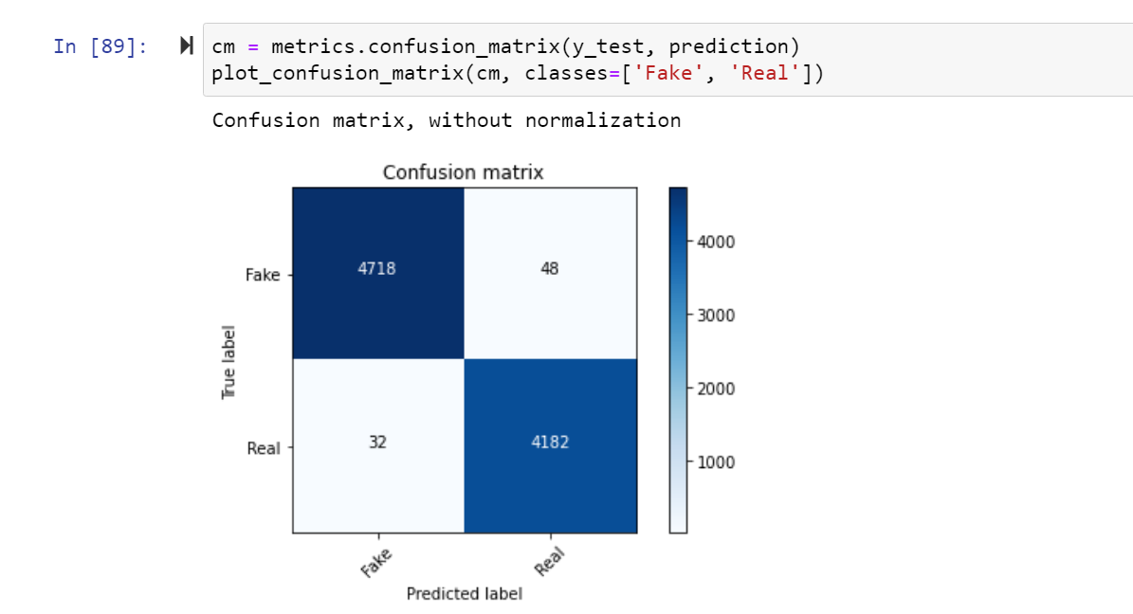

Slide 17
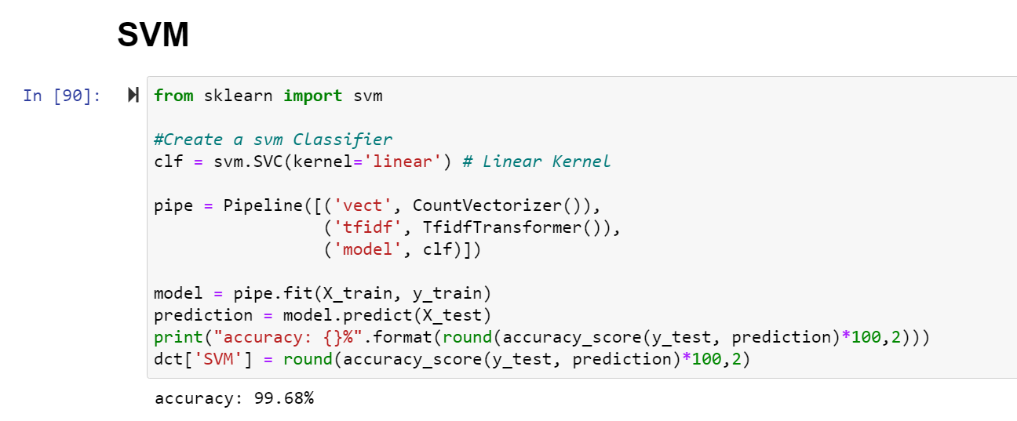
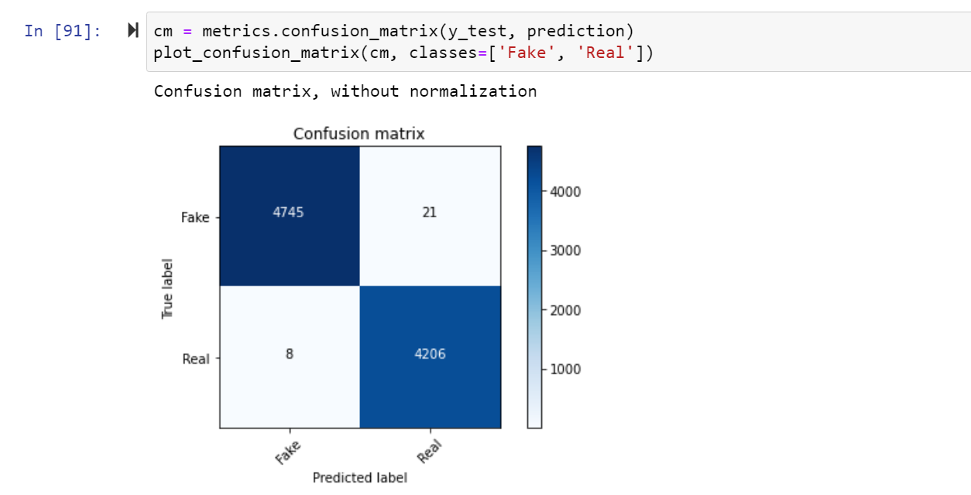

Slide 18
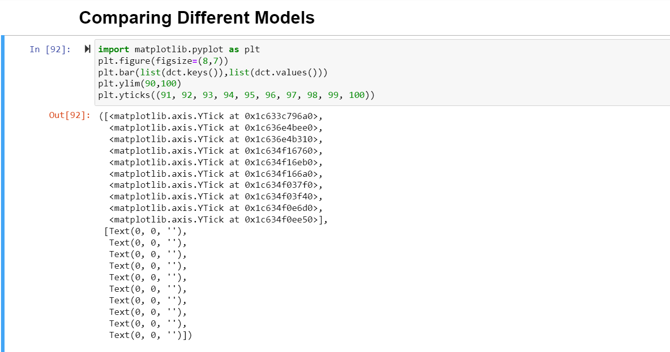
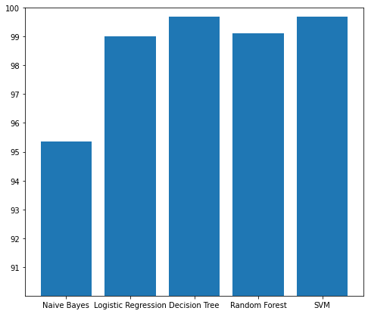

Slide 19
CONCLUSION
After the completion of this project, we got an insight of how to pre-process the data, analysing the data and building a model.
We did all the required pre-processing steps like checking null values, datatypes check, dropping unnecessary columns, etc.
-> We did the Exploratory Data Analysis using various plots and recorded the observations.
-> Using NLP, we pre-processed the comment text and did other steps like:
Removing Punctuations and other special characters
Splitting the comments into individual words
Removing Stop Words
Stemming and Lemmatising
Applying Count Vectorizer
Plotting wordcloud for knowing the weightage of words used

Slide 20
We found that LogisticRegression and RandomForestClassifier were performing well. The next step was to perform hyperparameter tuning
technique to these models for finding out the best parameters and trying to improve our scores.
-> LogisticRegression Algorithm gave us good scores and metric values than RandomForestClassifier and therefore we finalized it as the best model.

